Slide 1
Submittal to Eclipse.org

Slide 2
Enterprise Change Management
The Serena™ Vision, Strategy, & Framework
A single point of control to manage change to enterprise code and content throughout the application life cycle
  Deliver integrated multi-platform solutions
  Automate change process for software and Web content
  Best practices consulting ensures sound process
  Effective partnerships for end-to-end solution
A complete infrastructure to manage change to enterprise applications for quality, speed, and cost advantage

Slide 3
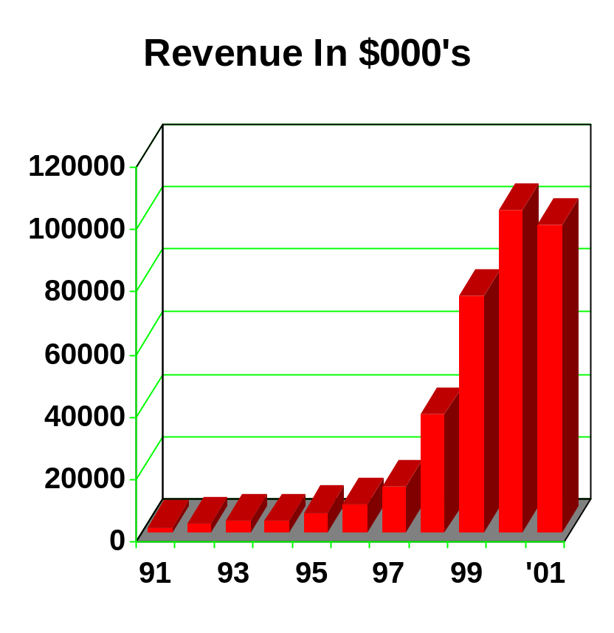
SERENA™ Software, Inc.
At a glance
Founded 1980;
NASDAQ - SRNA
Strong R&D Heritage
2,750+ customer sites
Global Presence
Financially solid and consistently profitable
Exclusively focused on Enterprise Change Management
Notes:
We are going to be around for a long time. Customers can depend upon us to be there when they need us. We have been in business since 1980, and we make money. We have a very strong R&D heritage. Our products are advanced and unique in the industry.
Emphasize the financial stability of the Company.
Re-emphasize the focus on managing change across the enterprise.
In FY01 SERENA came out at $104 million in revenue, which is a very rapid growth, as you can see in the graph.

Slide 4
SERENA™ Software, Inc.
Boris Kapitanski - Eclipse Board Member
Director, Distinguished Technology Officer Distributed Systems
  Creator of the first true Client/Server multi-platform change management solution – Serena ChangeMan™DS
  Responsible for the direction and architecture of the ChangeMan Family, including software and content management, request management and application lifecycle management.
  Lead Distributed R&D organization
Background:
  15 years of Software Development, 10 years specifically focused on SCM systems and architecture
Education
  Masters Degree in Physics and Applied Mathematics

Slide 5
SERENA™ Software, Inc.
Support of the Eclipse Framework
Involved with Eclipse program from inception
  Early work with WebDav before Eclipse direction changed
Serena ChangeMan™ DS & Serena ChangeMan WCM currently support VCM adopters
  Early development versions demonstrated at IBM events
  One of the first to announce & ship supported adapters
Serena is “Ready for WebSphere” validated
  Among first vendors to achieve this validation
Participating in follow on programs to connect to Serena ChangeMan ZMF (mainframe SCM)

Slide 6
SERENA™ Software Inc.
Public Support for Eclipse Framework
Serena has been a leader in public support for the Eclipse framework:
  Demonstrated support at WebSphere2001 in Austria, May 2001
    Supported with Live Demonstration based on early adapter version.
    Vendor PED, Conference Presentation
  Part of other Serena IBM presentations:
    WebSphere Technical Exchange, Nov. 2001
  Press Release supporting Workbench (June, 2001)
  Press Release supporting WSAD (Nov. 2001)
  Press Release “member of Eclipse board” (April 2002)

